Slide 1
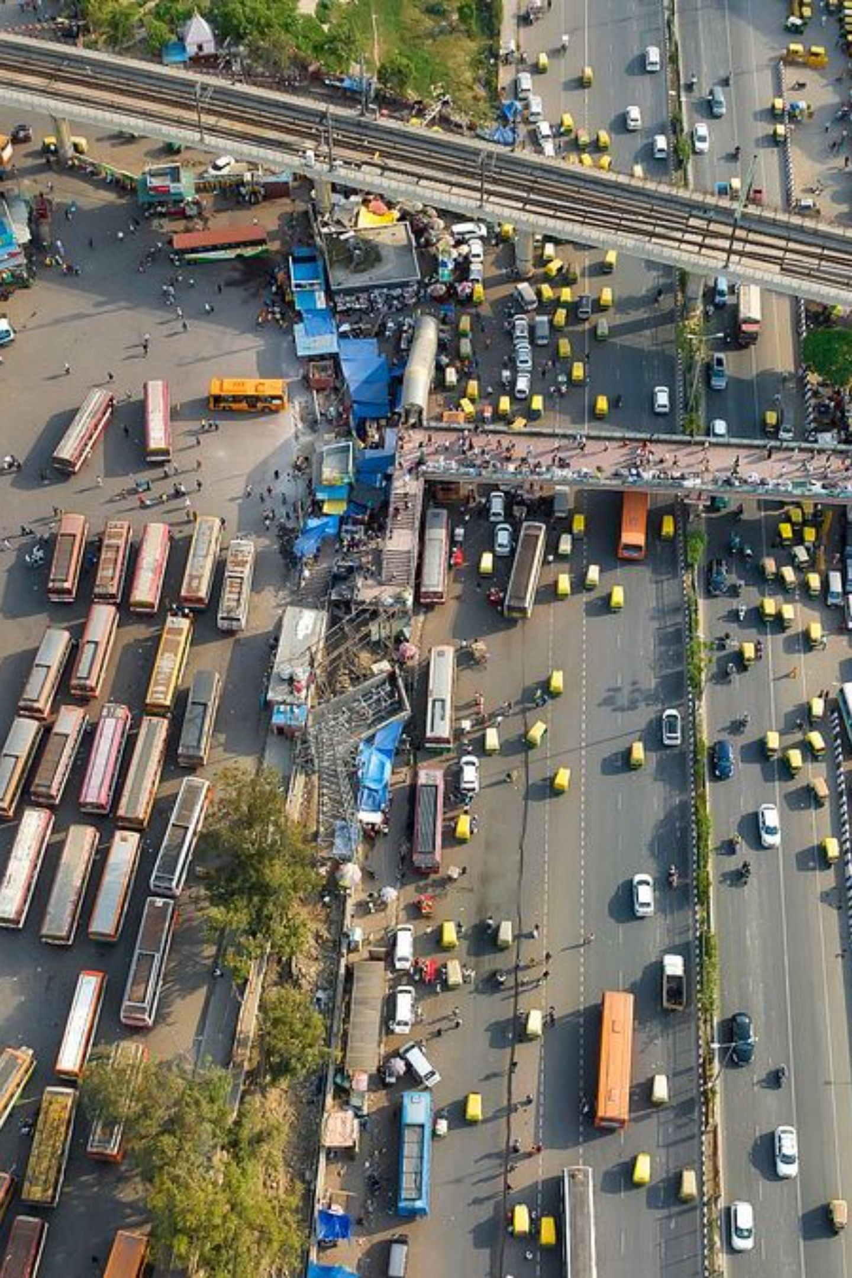
ADAPTIVE URBAN TRAFFIC SIGNAL OPTIMIZATION
Using Artificial Intelligence and Computer Vision
AMAN | SHANTANU | PRIYANSHU – B.Sc.(H) Computer Science
Proposal - Academic Project 2025-26

Slide 2
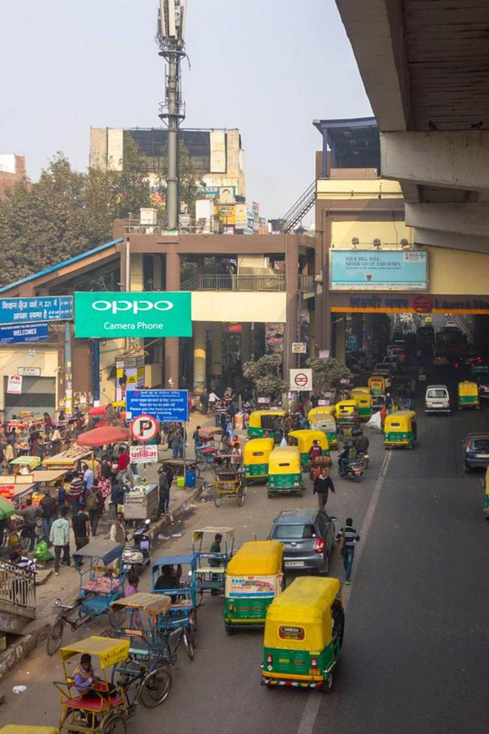
Problem Statement
Delhi roads have mixed traffic - car, bike, auto, e-rickshaw, bus, animal at same signal without lane discipline
Locations: Govind Puri, Kalkaji, Sarita Vihar crossing has heavy rush morning 8-10 and evening 5-8
Fixed timer signal 30 sec green wastes time when one side empty
Existing low cost methods using ultrasonic and RFID only detect presence, not vehicle type, need tag in ambulance
Foreign YOLO models use datasets without auto rickshaw class
Gap: No Indian dataset + YOLOv8 + adaptive logic + real Delhi testing combined

Slide 3
Literature Summary (6 papers only)
1. Zhang et al. 2022 - Improved YOLOv5 with Flip-Mosaic, CIoU/SIoU loss, 90.5% mAP50
2. DriveIndia 2024 IIT Hyderabad - 66986 images, 24 classes including auto, e-rickshaw, ambulance, pothole, animal, YOLOv8 benchmark 78.7% mAP50, auto 94% AP
3. Doria et al. 2025 Colombia - Compared YOLOv3 vs v5 vs v8 on 135k frames real junction, YOLOv5 best 0.63 mAP, car 0.94 AP best, bicycle/truck 0.22 low due to less data, cloudy best 0.85 AP, sunny worst 0.66 due to shadows
4. Kumareshan et al. 2025 EUDL - Adaptive control using YOLOv4-tiny + counting + digital pheromone (traffic pheromone = current jam, intention pheromone = future route), base framework
5. IJNRD 2023 - Arduino + ultrasonic density based signal
6. JETIR 2023 - IoT + RFID for emergency vehicle priority

Slide 4
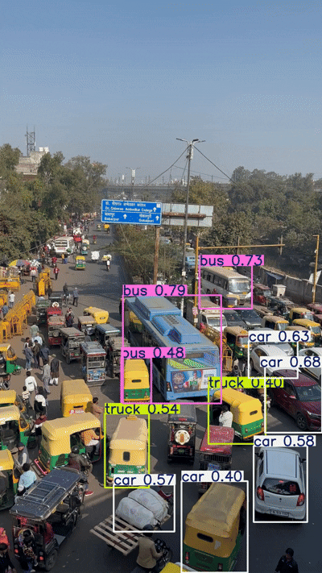
Detection Output & Observations
While doing detection of Delhi traffic with YOLO there are anomalies in heterogenous traffic
Overlapping bounding boxes in dense traffic
Small far vehicles missed
Auto and e-rickshaw confusion due to similar shape
Shadow and sunlight affect detection
These anomalies will be handled in fine-tuning

Slide 5
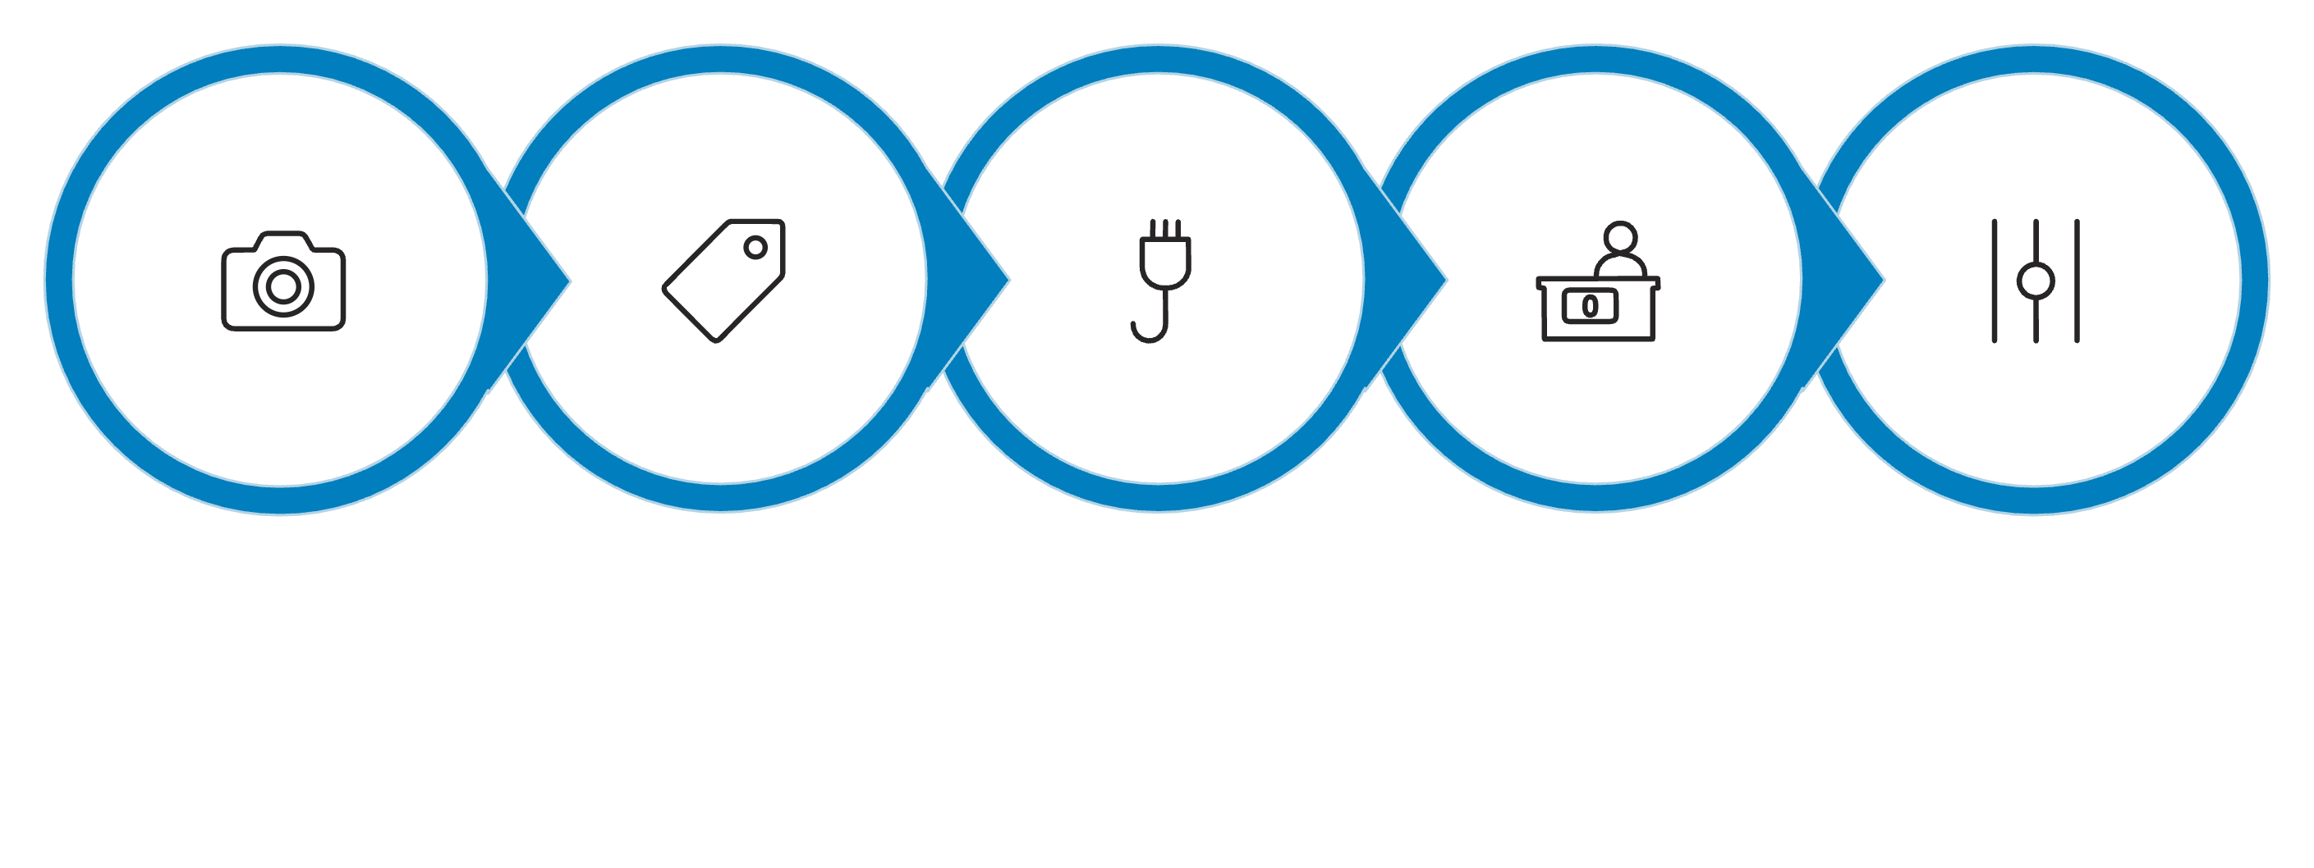

Proposed Methodology
Data Collection
Annotation
YOLOv8n Training
Vehicle Counting
Adaptive Logic
Data Collection (500 images from Govind Puri, Kalkaji, Sarita Vihar) -> Annotation in LabelImg YOLO format -> YOLOv8n Training in Google Colab (Flip-Mosaic, CIoU loss) -> Vehicle Counting per lane -> Adaptive Logic Green = 15 sec base + 2 sec * count, ambulance priority -> Testing in SUMO + Real Video
All open source free tools only - YOLOv8, Colab, SUMO, LabelImg. Keep broad so can adapt as per mentor expertise.

Slide 6
Expected Outcomes & Novelty
1
2
3
4
Solves classification problem ultrasonic cannot do - can tell auto vs e-rickshaw vs bike
Solves dataset problem - uses Indian DriveIndia plus own Delhi images
Uses existing CCTV, no extra RFID hardware needed
Fully open source free tools, any student can reproduce, can be made public
5
Working prototype not just toy model, can be tested at one crossing
Outcome: System that takes traffic video, detects with boxes, counts lane wise, suggests adaptive green time.

Slide 7
Work Plan & References
Work Plan
References
Aman - System integration and model training and final documentation
Shantanu - Testing and deployment and performance evaluation
Priyanshu - Data collection from and annotation
- Zhang et al. 2022 Improved YOLOv5
- DriveIndia 2024 IIT Hyderabad 67k images
- Doria et al. 2025 Future Transportation MDPI
- Kumareshan et al. 2025 EUDL EAI
- IJNRD 2023 Vol 8 Issue 4
- JETIR 2023 Vol 10 Issue 6
Thank You

